Slide 1
Chapter 16: Security

Slide 2
Chapter 16: Security
The Security Problem
Program Threats
System and Network Threats
Cryptography as a Security Tool
User Authentication
Implementing Security Defenses
Firewalling to Protect Systems and Networks
Computer-Security Classifications
An Example: Windows 7

Slide 3
Objectives
Discuss security threats and attacks
Explain the fundamentals of encryption, authentication, and hashing
Examine the uses of cryptography in computing
Describe the various countermeasures to security attacks

Slide 4
The Security Problem
System secure if resources used and accessed as intended under all circumstances
  Unachievable
Intruders (crackers) attempt to breach security
Threat is potential security violation
Attack is attempt to breach security
Attack can be accidental or malicious
Easier to protect against accidental than malicious misuse

Slide 5
Security Violation Categories
Breach of confidentiality
  Unauthorized reading of data
Breach of integrity
  Unauthorized modification of data
Breach of availability
  Unauthorized destruction of data
Theft of service
  Unauthorized use of resources
Denial of service (DOS)
  Prevention of legitimate use

Slide 6
Security Violation Methods
Masquerading (breach authentication)
  Pretending to be an authorized user to escalate privileges
Replay attack
  As is or with message modification
Man-in-the-middle attack
  Intruder sits in data flow, masquerading as sender to receiver and vice versa
Session hijacking
  Intercept an already-established session to bypass authentication
Privilege escalation
  Common attack type with access beyond what a user or resource is supposed to have

Slide 7
Security Measure Levels
Impossible to have absolute security, but make cost to perpetrator sufficiently high to deter most intruders
Security must occur at four levels to be effective:
  Physical
    Data centers, servers, connected terminals
  Application
    Benign or malicious apps can cause security problems
  Operating System
    Protection mechanisms, debugging
  Network
    Intercepted communications, interruption, DOS
Security is as weak as the weakest link in the chain
Humans a risk too via phishing and social-engineering attacks
But can too much security be a problem?

Slide 8
Program Threats
Many variations, many names
Trojan Horse
  Code segment that misuses its environment
  Exploits mechanisms for allowing programs written by users to be executed by other users
  Spyware, pop-up browser windows, covert channels
  Up to 80% of spam delivered by spyware-infected systems
Trap Door
  Specific user identifier or password that circumvents normal security procedures
  Could be included in a compiler
  How to detect them?

Slide 9
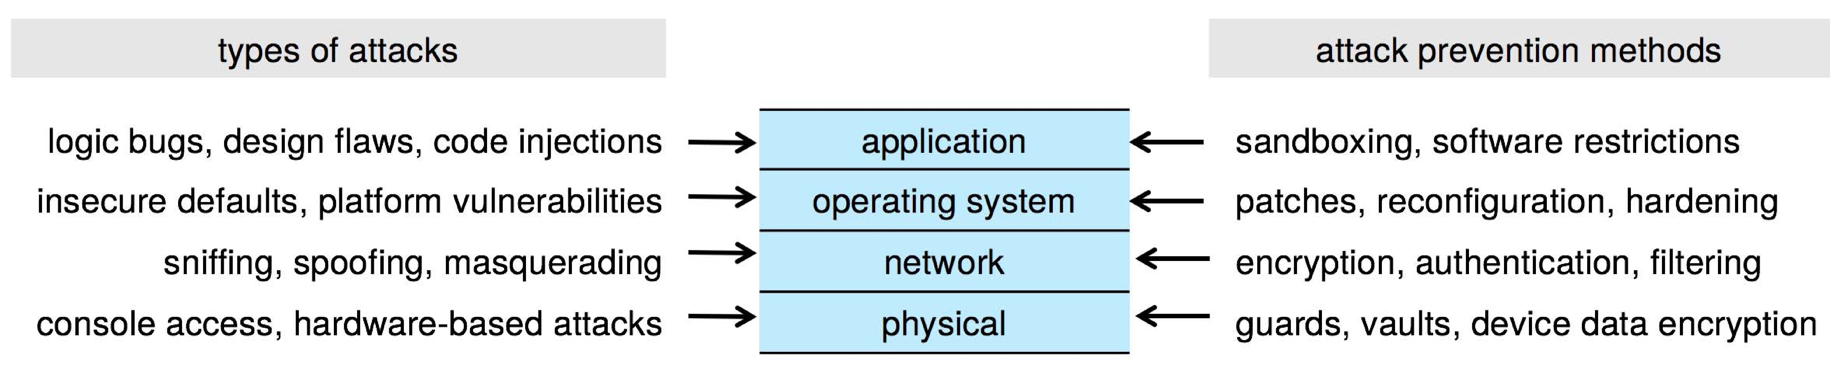
Four-layered Model of Security

Slide 10
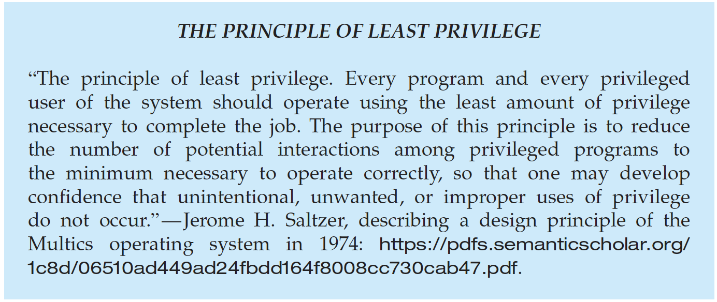
Program Threats (Cont.)
Malware - Software designed to exploit, disable, or damage computer
Trojan Horse – Program that acts in a clandestine manner
  Spyware – Program frequently installed with legitimate software to display adds, capture user data
  Ransomware – locks up data via encryption, demanding payment to unlock it
Others include trap doors, logic boms
All try to violate the Principle of Least Privilege
Goal frequently is to leave behind Remote Access Tool (RAT) for repeated access

Slide 11
C Program with Buffer-overflow Condition
#include <stdio.h>
#define BUFFER SIZE 256
int main(int argc, char *argv[])
{
char buffer[BUFFER SIZE];
if (argc < 2)
return -1;
else {
strcpy(buffer,argv[1]);
return 0;
}
}
Code review can help – programmers review each other’s code, looking for logic flows, programming flaws

Slide 12
Code Injection
Code-injection attack occurs when system code is not malicious but has bugs allowing executable code to be added or modified
  Results from poor or insecure programming paradigms, commonly in low level languages like C or C++ which allow for direct memory access through pointers
  Goal is a buffer overflow in which code is placed in a buffer and execution caused by the attack
  Can be run by script kiddies – use tools written but exploit identifiers

Slide 13
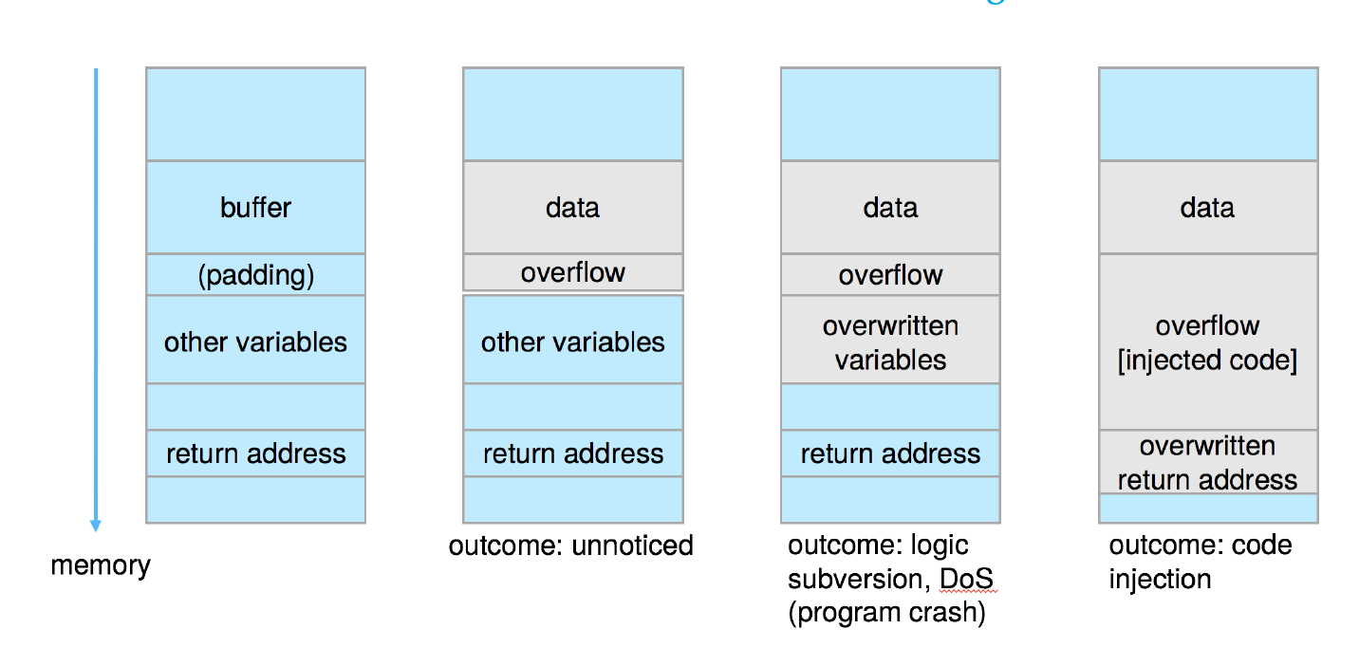
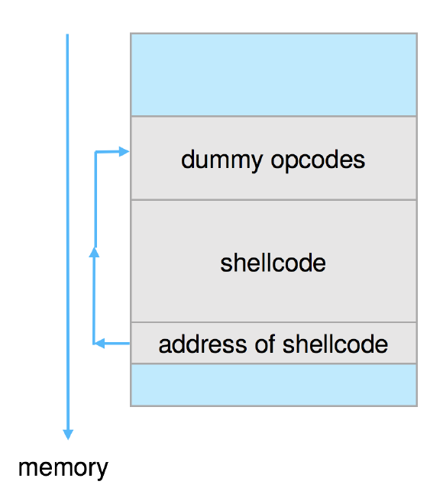
Code Injection (cont.)
  Outcomes from code injection include:
  Frequently use trampoline to code execution to exploit buffer overflow:

Slide 14
Great Programming Required?
For the first step of determining the bug, and second step of writing exploit code, yes
Script kiddies can run pre-written exploit code to attack a given system
Attack code can get a shell with the processes’ owner’s permissions
  Or open a network port, delete files, download a program, etc
Depending on bug, attack can be executed across a network using allowed connections, bypassing firewalls
Buffer overflow can be disabled by disabling stack execution or adding bit to page table to indicate “non-executable” state
  Available in SPARC and x86
  But still have security exploits

Slide 15
Program Threats (Cont.)
Viruses
  Code fragment embedded in legitimate program
  Self-replicating, designed to infect other computers
  Very specific to CPU architecture, operating system, applications
  Usually borne via email or as a macro
  Visual Basic Macro to reformat hard drive
    Sub AutoOpen()
    Dim oFS
    Set oFS = CreateObject(’’Scripting.FileSystemObject’’)
    vs = Shell(’’c:command.com /k format c:’’,vbHide)
    End Sub

Slide 16
Program Threats (Cont.)
Virus dropper inserts virus onto the system
Many categories of viruses, literally many thousands of viruses
  File / parasitic
  Boot / memory
  Macro
  Source code
  Polymorphic to avoid having a virus signature
  Encrypted
  Stealth
  Tunneling
  Multipartite
  Armored

Slide 17
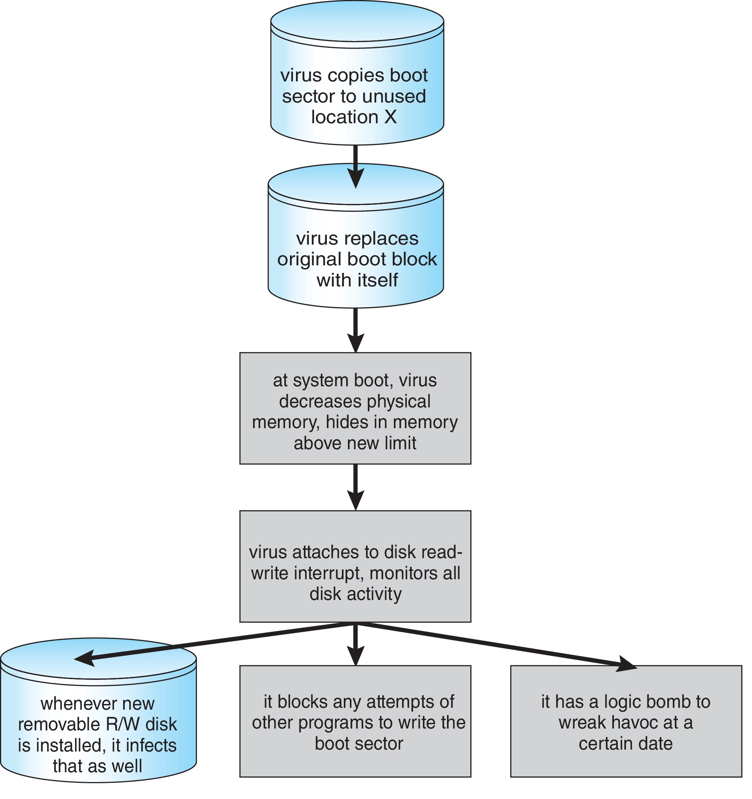
A Boot-sector Computer Virus

Slide 18
The Threat Continues
Attacks still common, still occurring
Attacks moved over time from science experiments to tools of organized crime
  Targeting specific companies
  Creating botnets to use as tool for spam and DDOS delivery
  Keystroke logger to grab passwords, credit card numbers
Why is Windows the target for most attacks?
  Most common
  Everyone is an administrator
    Licensing required?
  Monoculture considered harmful

Slide 19
System and Network Threats
Some systems “open” rather than secure by default
  Reduce attack surface
  But harder to use, more knowledge needed to administer
Network threats harder to detect, prevent
  Protection systems weaker
  More difficult to have a shared secret on which to base access
  No physical limits once system attached to internet
    Or on network with system attached to internet
  Even determining location of connecting system difficult
    IP address is only knowledge

Slide 20
System and Network Threats (Cont.)
Worms – use spawn mechanism; standalone program
Internet worm
  Exploited UNIX networking features (remote access) and bugs in finger and sendmail programs
  Exploited trust-relationship mechanism used by rsh to access friendly systems without use of password
  Grappling hook program uploaded main worm program
    99 lines of C code
  Hooked system then uploaded main code, tried to attack connected systems
  Also tried to break into other users accounts on local system via password guessing
  If target system already infected, abort, except for every 7th time

Slide 21
System and Network Threats (Cont.)
Port scanning
  Automated attempt to connect to a range of ports on one or a range of IP addresses
  Detection of answering service protocol
  Detection of OS and version running on system
  nmap scans all ports in a given IP range for a response
  nessus has a database of protocols and bugs (and exploits) to apply against a system
  Frequently launched from zombie systems
    To decrease trace-ability

Slide 22
System and Network Threats (Cont.)
Denial of Service
  Overload the targeted computer preventing it from doing any useful work
  Distributed Denial-of-Service (DDoS) come from multiple sites at once
  Consider the start of the IP-connection handshake (SYN)
    How many started-connections can the OS handle?
  Consider traffic to a web site
    How can you tell the difference between being a target and being really popular?
  Accidental – CS students writing bad fork() code
  Purposeful – extortion, punishment
Port scanning
  Automated tool to look for network ports accepting connections
  Used for good and evil

Slide 23
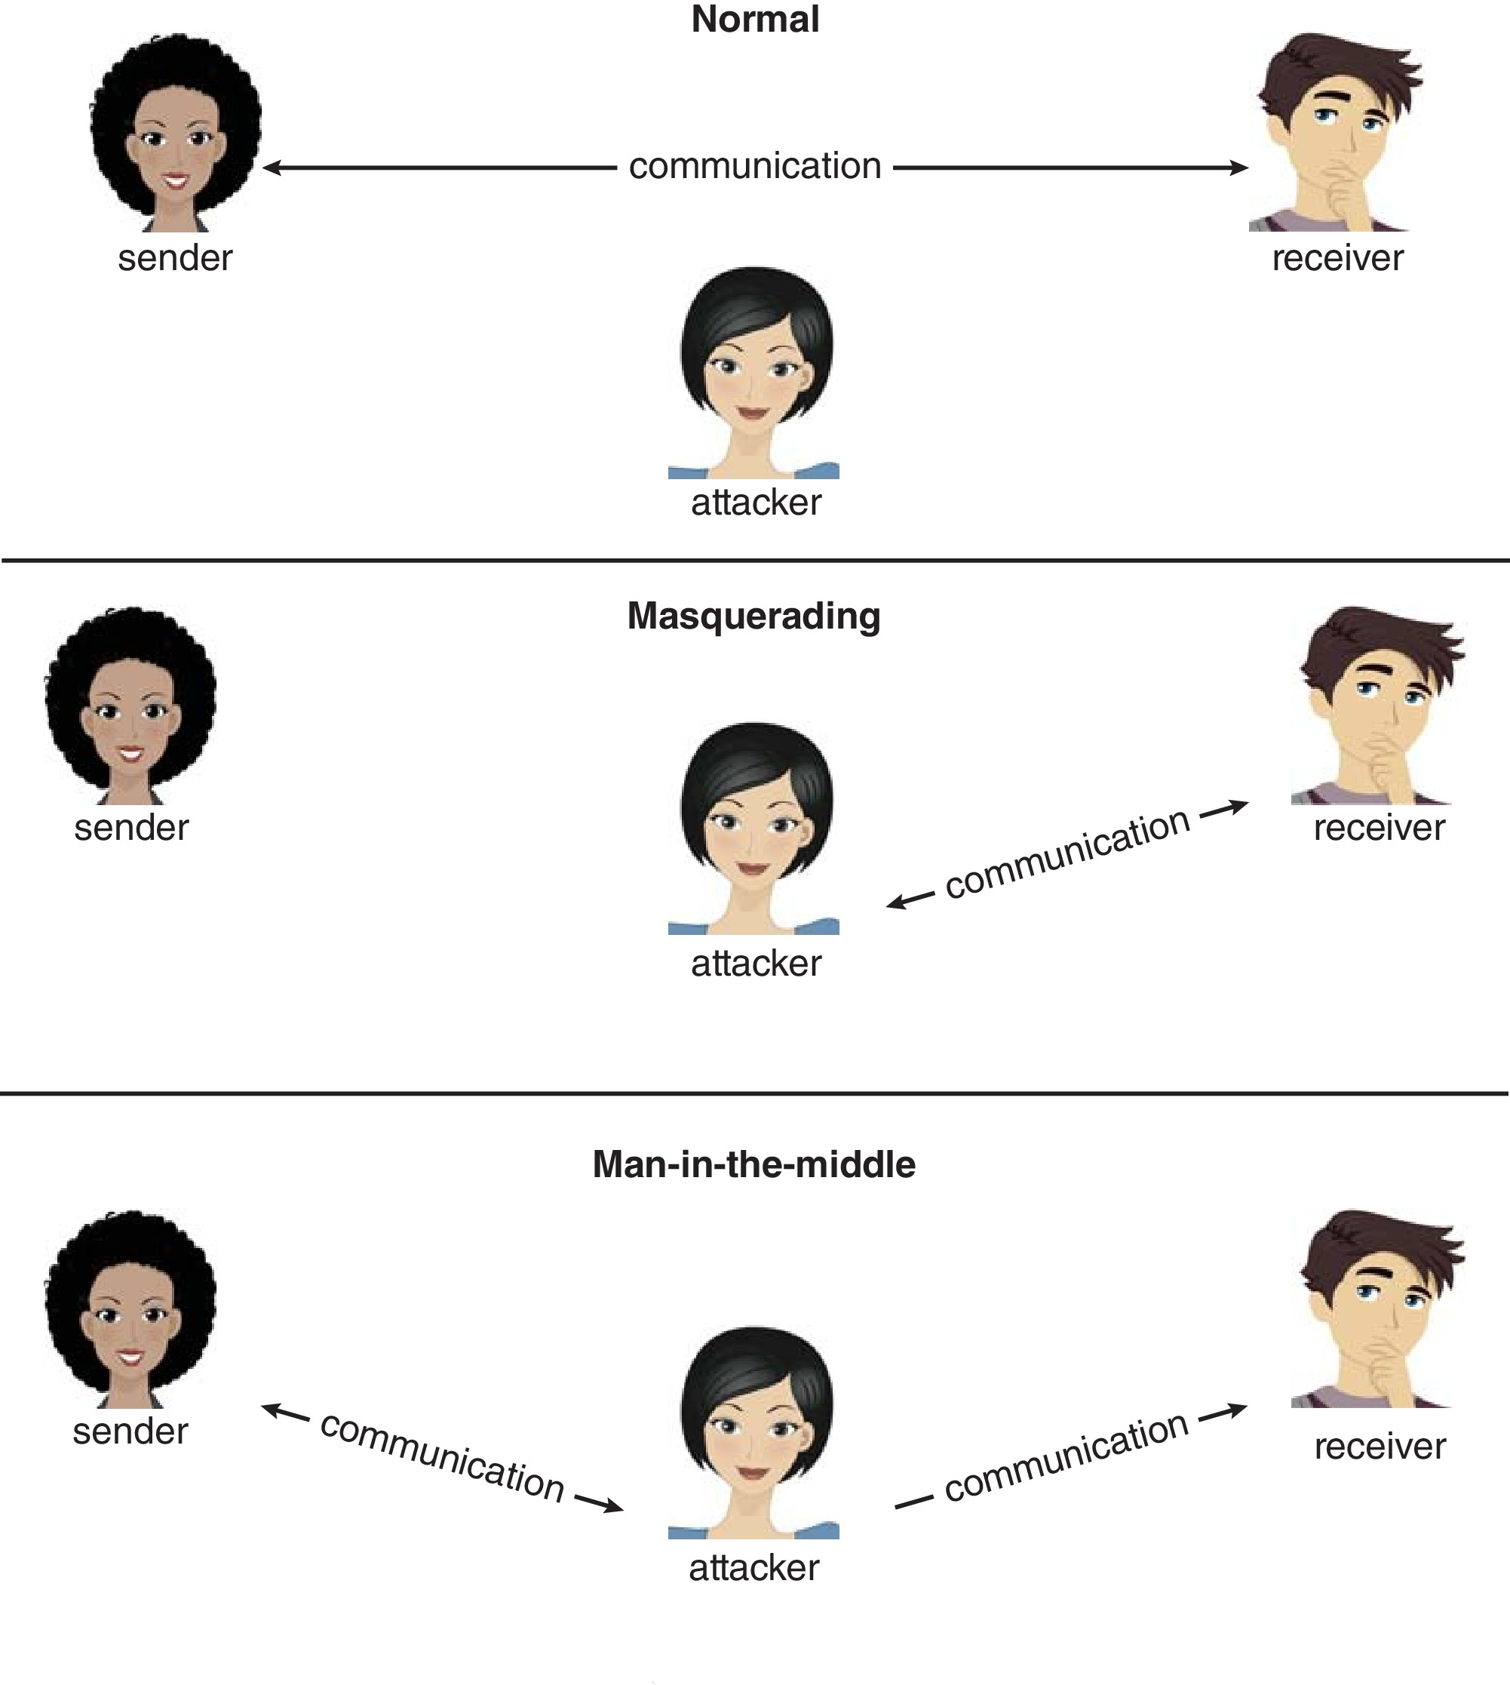
Standard Security Attacks

Slide 24
Cryptography as a Security Tool
Broadest security tool available
  Internal to a given computer, source and destination of messages can be known and protected
    OS creates, manages, protects process IDs, communication ports
  Source and destination of messages on network cannot be trusted without cryptography
    Local network – IP address?
      Consider unauthorized host added
    WAN / Internet – how to establish authenticity
      Not via IP address

Slide 25
Cryptography
Means to constrain potential senders (sources) and / or receivers (destinations) of messages
  Based on secrets (keys)
  Enables
    Confirmation of source
    Receipt only by certain destination
    Trust relationship between sender and receiver

Slide 26
Implementing Security Defenses
Defense in depth is most common security theory – multiple layers of security
Security policy describes what is being secured
Vulnerability assessment compares real state of system / network compared to security policy
Intrusion detection endeavors to detect attempted or successful intrusions
  Signature-based detection spots known bad patterns
  Anomaly detection spots differences from normal behavior
    Can detect zero-day attacks
  False-positives and false-negatives a problem
Virus protection
  Searching all programs or programs at execution for known virus patterns
  Or run in sandbox so can’t damage system
Auditing, accounting, and logging of all or specific system or network activities
Practice safe computing – avoid sources of infection, download from only “good” sites, etc

Slide 27
Firewalling to Protect Systems and Networks
A network firewall is placed between trusted and untrusted hosts
  The firewall limits network access between these two security domains
Can be tunneled or spoofed
  Tunneling allows disallowed protocol to travel within allowed protocol (i.e., telnet inside of HTTP)
  Firewall rules typically based on host name or IP address which can be spoofed
Personal firewall is software layer on given host
  Can monitor / limit traffic to and from the host
Application proxy firewall understands application protocol and can control them (i.e., SMTP)
System-call firewall monitors all important system calls and apply rules to them (i.e., this program can execute that system call)

Slide 28
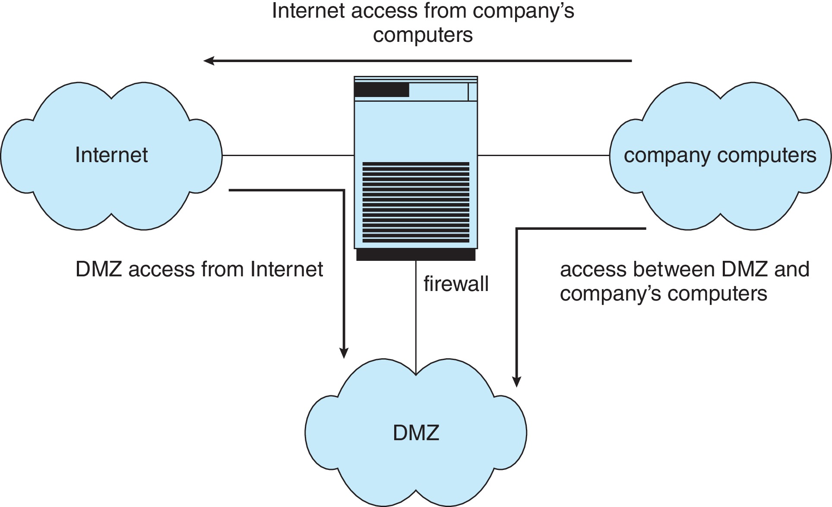
Network Security Through Domain Separation Via Firewall

Slide 29
Example: Windows 10
Security is based on user accounts
  Each user has unique security ID
  Login to ID creates security access token
    Includes security ID for user, for user’s groups, and special privileges
    Every process gets copy of token
    System checks token to determine if access allowed or denied
Uses a subject model to ensure access security
  A subject tracks and manages permissions for each program that a user runs
Each object in Windows has a security attribute defined by a security descriptor
  For example, a file has a security descriptor that indicates the access permissions for all users

Slide 30
Example: Windows 7 (Cont.)
Win added mandatory integrity controls – assigns integrity label to each securable object and subject
  Subject must have access requested in discretionary access-control list to gain access to object
Security attributes described by security descriptor
  Owner ID, group security ID, discretionary access-control list, system access-control list
Objects are either container objects (containing other objects, for example a file system directory) or noncontainer objects
  By default an object created in a container inherits permissions from the parent object
Some Win 10 security challenges result from security settings being weak by default, the number of services included in a Win 10 system, and the number of applications typically installed on a Win 10 system

Slide 31
End of Chapter 16

